Slide 1
Electronics & Electricity
Unit 8 – Schematic Builds
Quiz Review

Slide 2
Schematic Builds
Quiz Review

Slide 3
Ohms Law

Slide 4
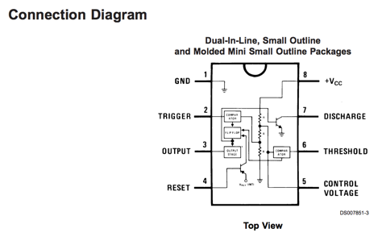

Slide 5
Capacitor

Slide 6
Capacitor

Slide 7
Resistor

Slide 8
Battery or voltage source

Slide 9
Transistor

Slide 10
Potentiometer

Slide 11


555 Timer IC

Slide 12
Light Emitting Diode

Slide 13
Connected wires with a node

Slide 14
Phototransistor

Slide 15
Light-dependent resistor

Slide 16
Push Button Switch

Slide 17
Piezo Speaker

Slide 18
Capacitors are measured in what unit?
- Farad
the ability of a body to store an electrical charge

